Slide 1



FlipItPhysics
First Day of Class
www.FlipItPhysics.com

Slide 2
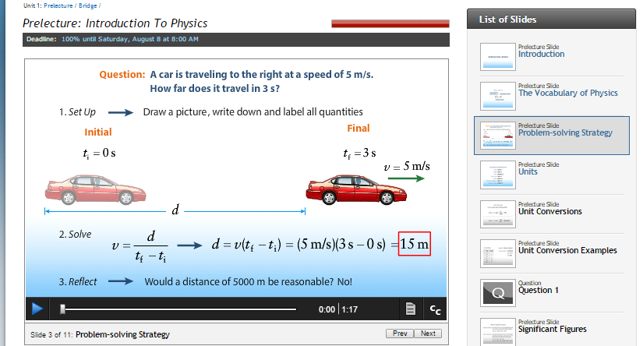
What is FlipItPhysics?
FlipItPhysics is an online course space that includes:
Engaging multimedia
Opportunities to communicate to your instructor
Spaces to practice what you’ve learned

Slide 3
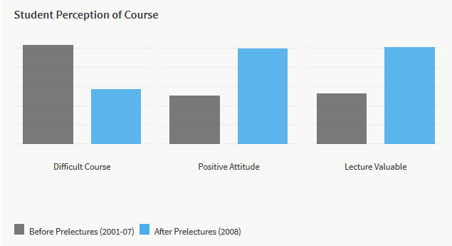
PLAIN COVER
Use this cover where you do not want to use and image. Add the Macmillan Education logo and a single sub brand or lock up to the base logo strip as required
What are other students saying about FlipItPhysics?

Slide 4
PLAIN COVER
Use this cover where you do not want to use and image. Add the Macmillan Education logo and a single sub brand or lock up to the base logo strip as required
What can FlipItPhysics do for you?
FlipIt can help you:
Come to class prepared
Improve your understanding of the course content
Engage in class
Prep for tests and quizzes

Slide 5
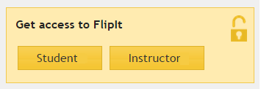
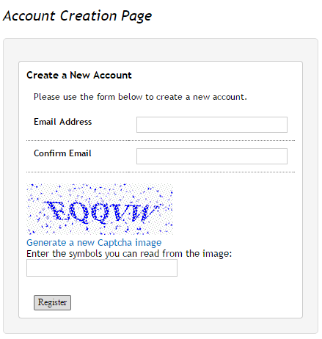
PLAIN COVER
Use this cover where you do not want to use and image. Add the Macmillan Education logo and a single sub brand or lock up to the base logo strip as required
So how do you get
into FlipItPhysics?
Go to www.flipitphysics.com and click “Student” in the Get access to FlipIt box
Complete the Account Creation Page and click “Register”

Slide 6
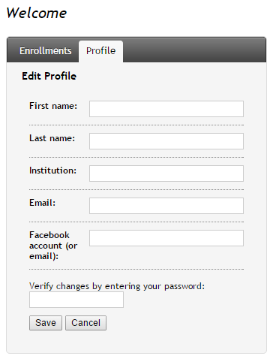
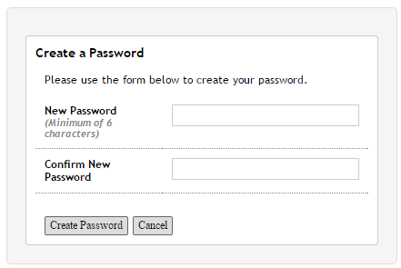
PLAIN COVER
Use this cover where you do not want to use and image. Add the Macmillan Education logo and a single sub brand or lock up to the base logo strip as required
So how do you get
into FlipItPhysics?
You’ll receive an email with a link to continue your registration and create a password
Set up your Profile and click “Save”

Slide 7
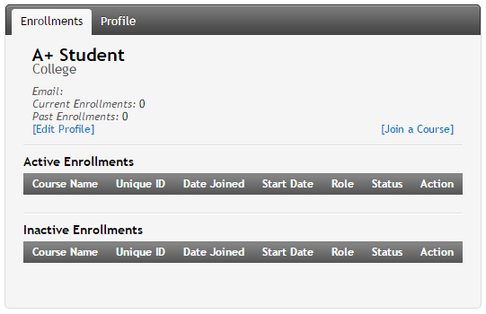
PLAIN COVER
Use this cover where you do not want to use and image. Add the Macmillan Education logo and a single sub brand or lock up to the base logo strip as required
So how do you get
into FlipItPhysics?
5. Choose the “Enrollments” tab and click “Join a Course”

Slide 8
PLAIN COVER
Use this cover where you do not want to use and image. Add the Macmillan Education logo and a single sub brand or lock up to the base logo strip as required
So how do you get
into FlipItPhysics?
5. Enter your Course Access Key and click “Get Course”
6. If prompted, enter your Student ID (ID used in Blackboard, Moodle, Canvas, etc.) and click “Enroll in Course”

Slide 9
PLAIN COVER
Use this cover where you do not want to use and image. Add the Macmillan Education logo and a single sub brand or lock up to the base logo strip as required
So how do you get
into FlipItPhysics?
The COURSE ACCESS KEY for this course is:
[Instructors: The Course Access Key can be found by going to “Instructor Links”, “Global Course Settings”, and copying the editable code from the “Course access key” box. Students need this code to get into your course.]

Slide 10
PLAIN COVER
Use this cover where you do not want to use and image. Add the Macmillan Education logo and a single sub brand or lock up to the base logo strip as required
So how can you get into FlipItPhysics?
Congratulations! You are now enrolled in your course!
You will be given 21 days to access FlipItPhysics before having to purchase access or redeem an access code. This will provide you with a grace period should you opt to drop the course.

Slide 11
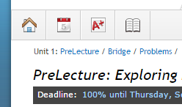
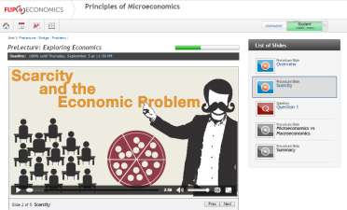
PLAIN COVER
Use this cover where you do not want to use and image. Add the Macmillan Education logo and a single sub brand or lock up to the base logo strip as required
What do I do in FlipItPhysics?
You will view PreLectures and complete Bridge questions before class.
You will complete Problem questions after class.

Slide 12
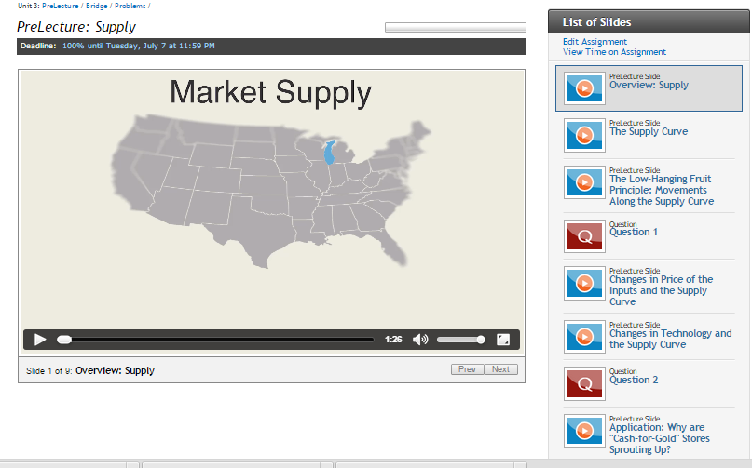
PLAIN COVER
Use this cover where you do not want to use and image. Add the Macmillan Education logo and a single sub brand or lock up to the base logo strip as required
What do I do in FlipItPhysics?
You will view
PreLectures
before class to gain a baseline understanding of a topic.

Slide 13
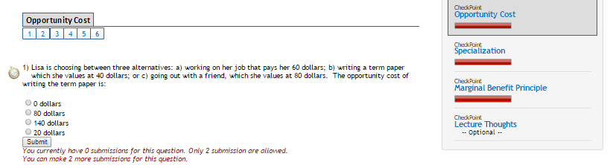
PLAIN COVER
Use this cover where you do not want to use and image. Add the Macmillan Education logo and a single sub brand or lock up to the base logo strip as required
What do I do in FlipItPhysics?
You will complete Bridge questions before class to check your understanding of the PreLecture.

Slide 14
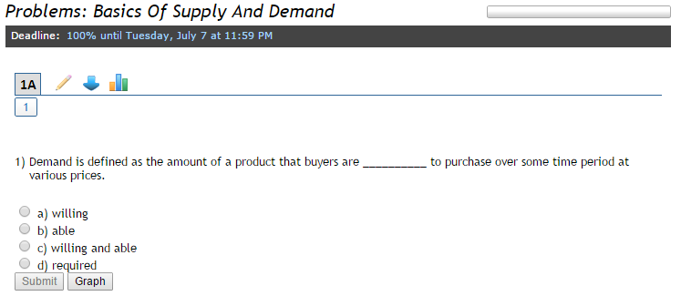
PLAIN COVER
Use this cover where you do not want to use and image. Add the Macmillan Education logo and a single sub brand or lock up to the base logo strip as required
What do I do in FlipItPhysics?
You will complete Homework Problems.

Slide 15

Where can you get more help?
Go to macmillanhighered.com/getsupport
Phone: 1-800-936-6899
Online form: http://support.bfwpub.com/supportform/form.php
Technical Support Hours (Eastern Time)
Monday through Thursday 7:00 a.m. to 3:00 a.m.
Friday 7:00 a.m. to 11:00 p.m.
Saturday 11:30 a.m. 8:00 p.m.
Sunday 11:30 a.m. to 11:00 p.m.

